Slide 1

SHAMANISM AND DREAMS
Presented by: Laiba Fatima Khan
Angela Sumegi
Presented by: Laiba Fatima Khan

Slide 2
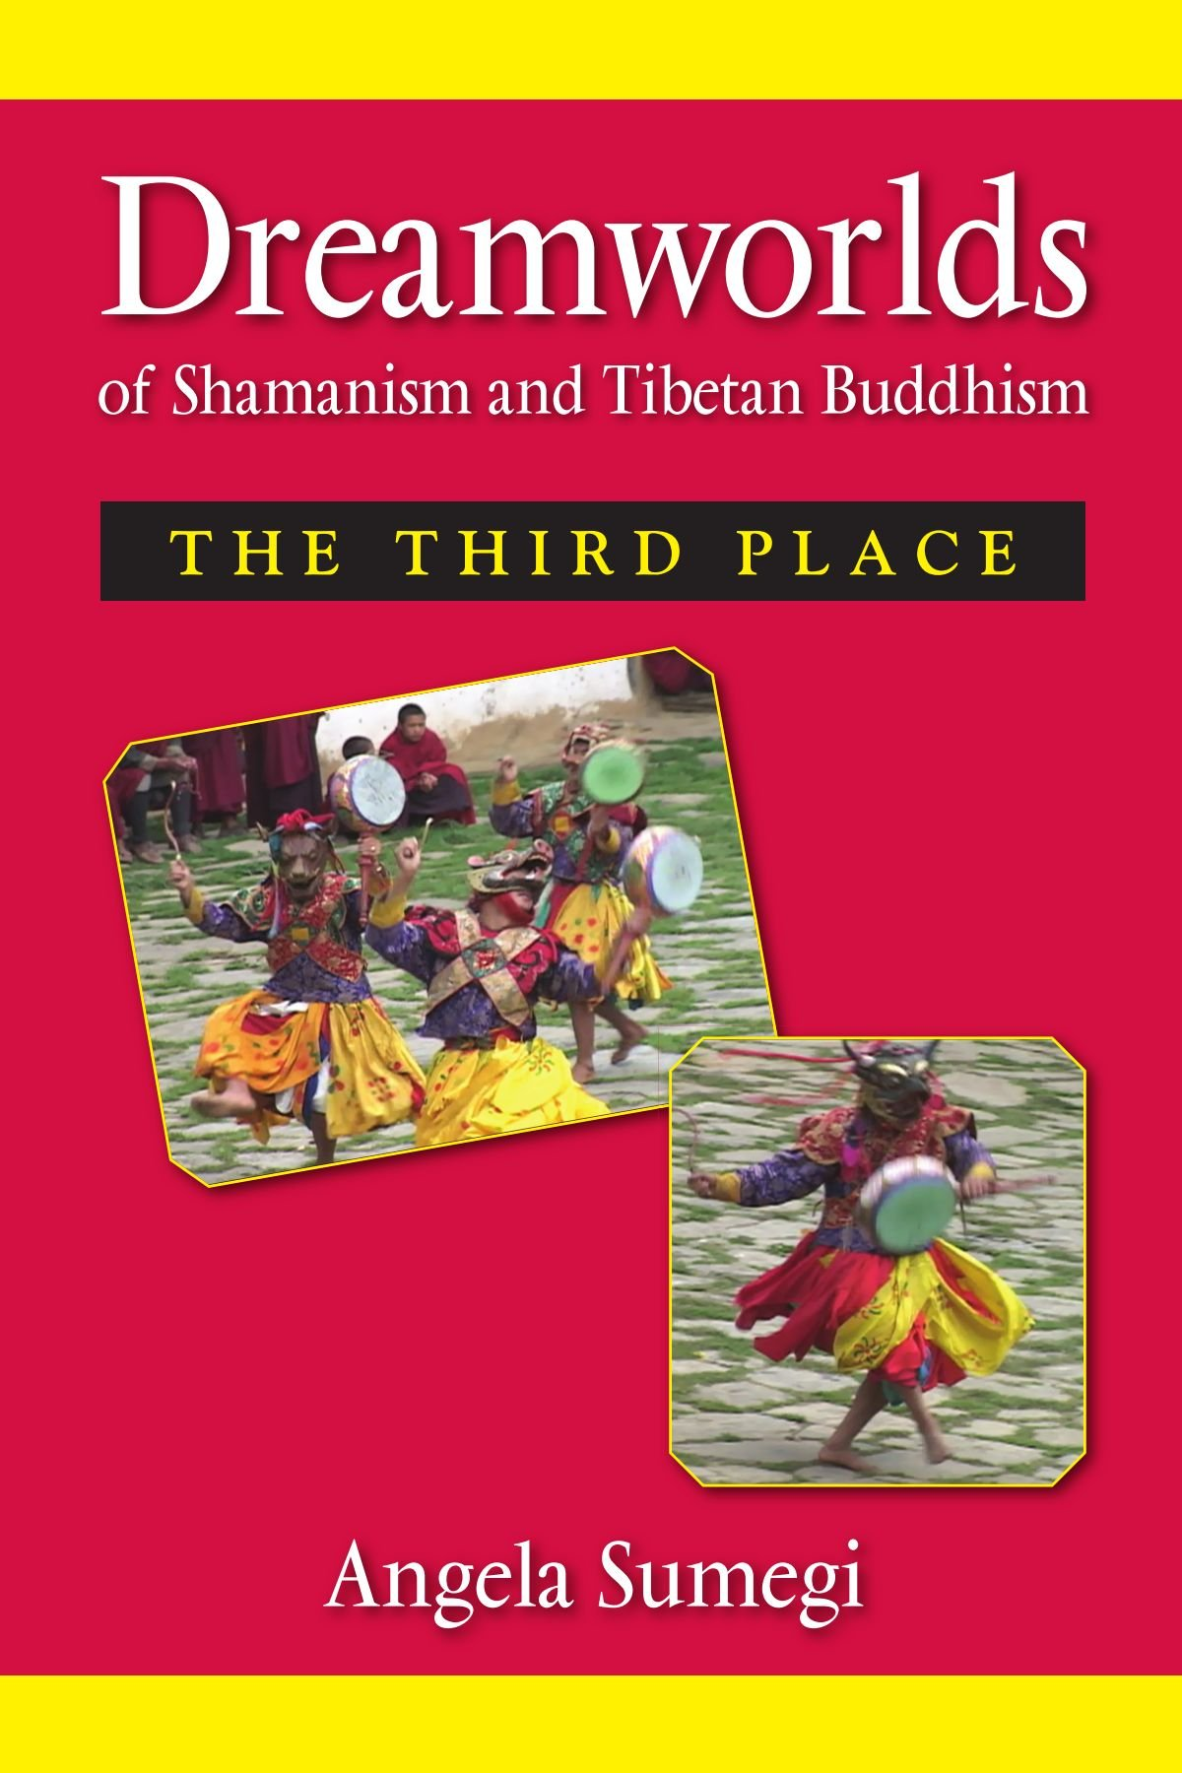
In this Presentation, we’ll discuss:
What is Shamanism?
The Shamanic World View
Dreams and Shamanism
Shamanic practices among Muslims???

Slide 3
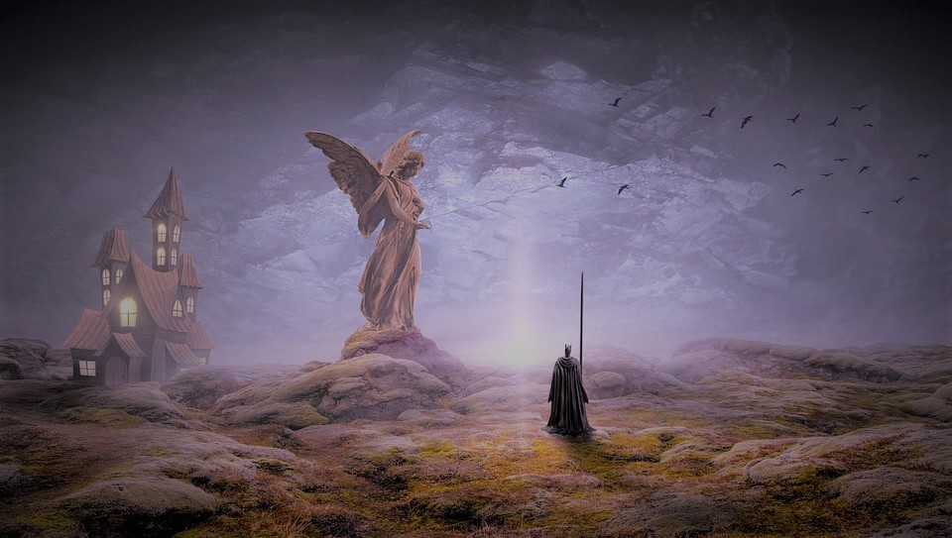
The Shamanic Belief System
Michel Perrin’s Analysis
Shamanic Belief System functions on 3 basic characteristics:
Double nature of humans and their environment
The Shaman’s ability to communicate intentionally with the spirit world
The relationship between the Shaman and the community.

Slide 4
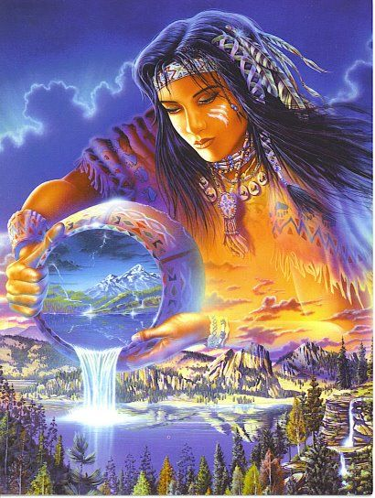
The Shamanic World View
Various Dimensions of the Cosmos
Animism: The World as Being
Lha: The Deities and Spirits

Slide 5
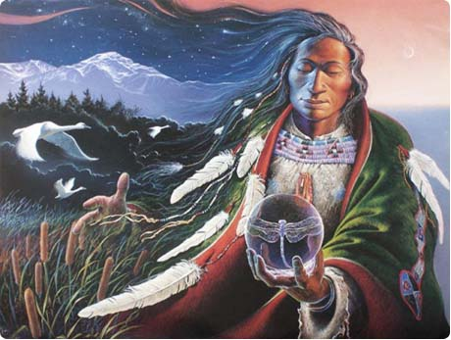
The World as Being
In Tibetan traditional history, the dominion of Buddhism over their world is portrayed in the image of the land itself as a great demoness captured and pinned by twelve “limb-binding” temples.

Slide 6
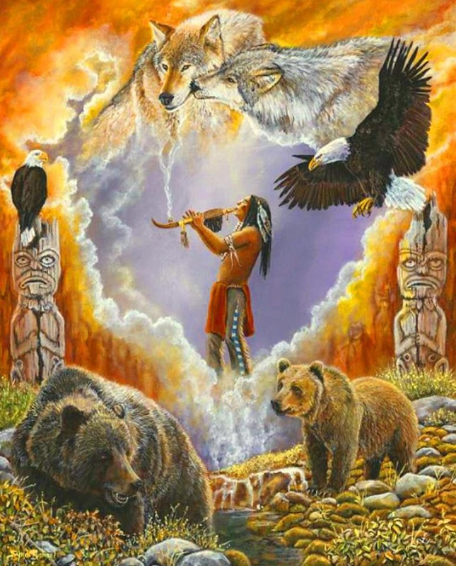
Deities and Spirits Related to Specific Cosmic Zones:
The benevolent gods (lha) occupy the upper world of sky or heaven.
Mountain spirits (the nyen and tsen) and the “earth-lords” or “soil-owners” (sadak) dwell in the middle zone of earth.
the water-serpent spirits (lu) make their homes in the lower realms under the earth and in the depths of lakes and rivers.
In the Tibetan texts, the power of the gods manifests through their relationship to humans.

Slide 7
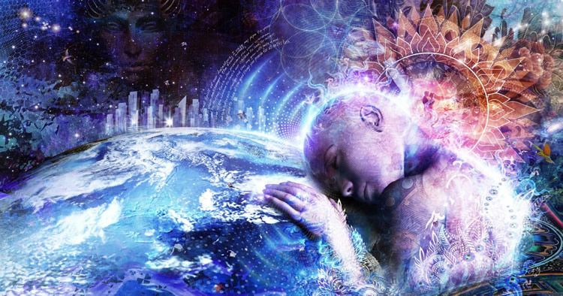
Dreamworlds of Shamanism

Slide 8
Following beliefs are part of many Shamanisms:
Sleep as a state during which the soul leaves the body
Helping spirits (ancestors, animals, or any kind of phenomena can act as spirit guides)
Agreement established between the soul and helping spirit
Sleep and dream as a space/time dimension in which the Shaman’s soul can travel either to the realm of the spirits or to another place in the physical world
firsthand knowledge brought back and shared with the community

Slide 9
Using the Ordinary in Extraordinary Ways:
Mihaly Hoppal draws attention to a number of everyday activities that take on particular significance for Shamans:
Sleeping: related to the beginning or ending of an ecstatic trance,
Yawning: related to the taking in of helping spirits,
Dreaming: related to soul travel and the acquisition of knowledge, and
Fasting: related to the preparation for trance.

Slide 10

Shamanic power and activity are intimately associated with sleep and dream, which in turn are linked with the realm of spirits and death.
“The Shaman’s dream is as a mode of communication and a journey to other worlds, for creating reality, revealing knowledge, and bestowing power.”

Slide 11
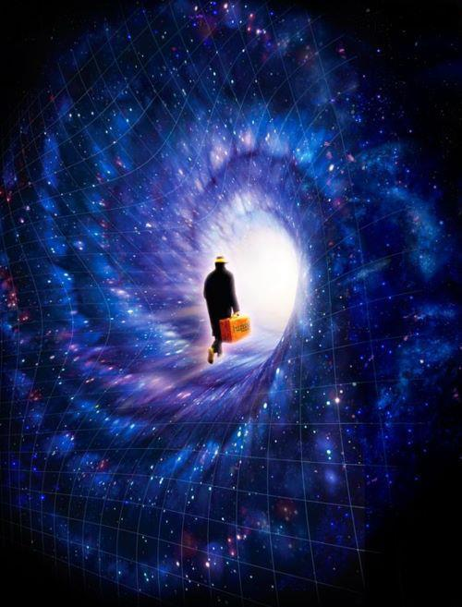
“In the Tungus tradition, it is understood that sleep can be used as a method of entering into an altered state of consciousness or alternate reality mode, in which the shaman acts.
The battles fought between shamans were said to take place during sleep and dream.”

Slide 12
Dreams of the Shaman and Healing
The beginning of the shaman’s ability to heal lies in the Shaman’s own experience of sickness and the initiatory dream (or vision) in which he encounters the spirits who are responsible for his condition and who will become his allies.
“I have been sick and I have been dreaming. In my dreams I had been taken to the ancestor and cut into pieces on a black table. They chopped me up and then threw me into the kettle and I was boiled. . . . When I came to from this state, I woke up. This meant that my soul had returned. Then the shamans declared: ‘You are the sort of man who may become a shaman. You should become a shaman, you must begin to Shamanize!’ ”
(Initiatory dream of a Siberian Shaman)

Slide 13
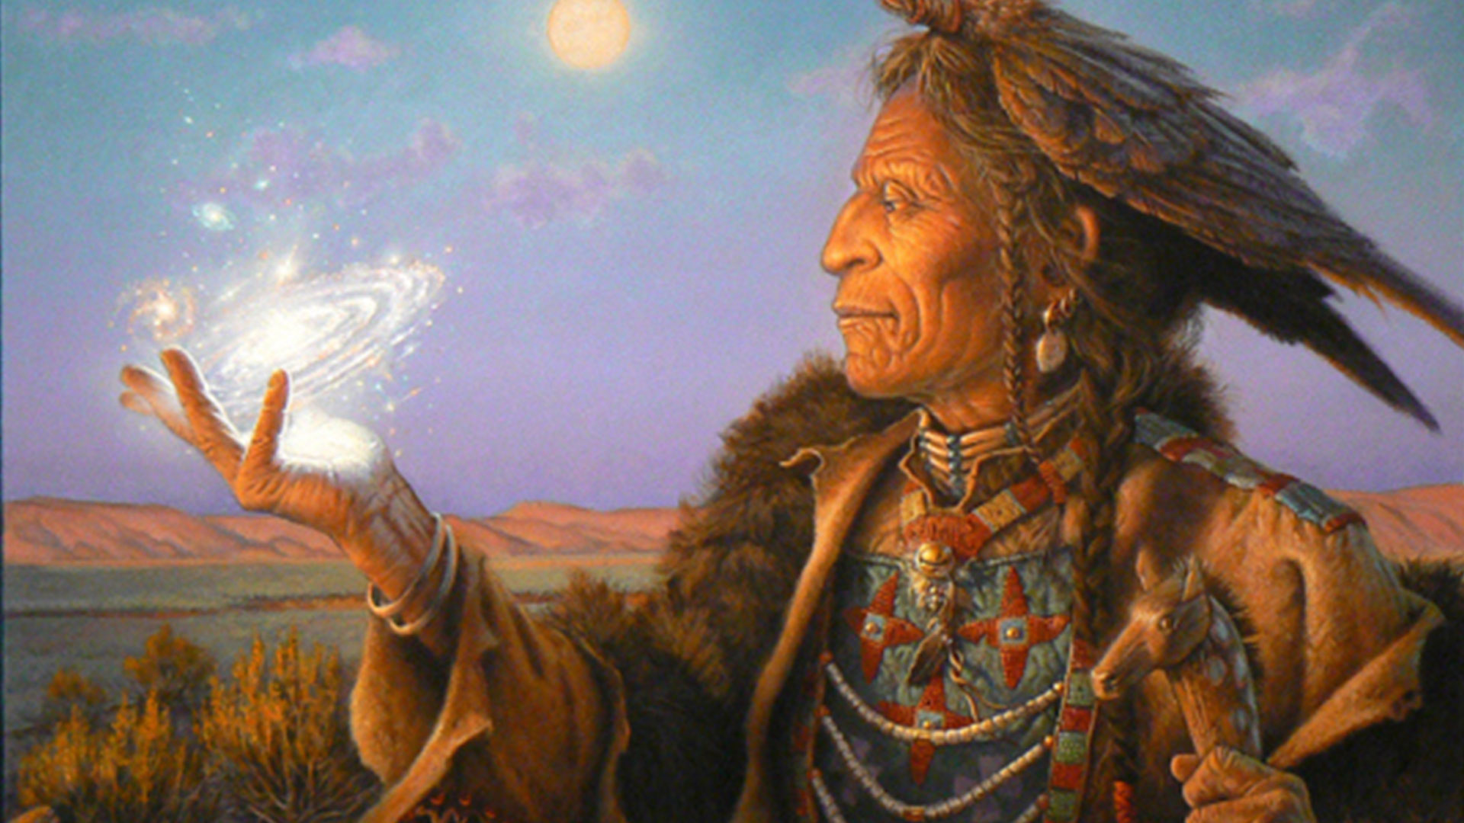
Shamanic Practices among muslims
In Sudhir Kakar’s study of the healing practices of a Muslim Pir (wise elder),
the Pir explains that the ‘holy water’ he gives his patients drives demons away by literally washing the blood so that the demon can no longer drink it and is, therefore, forced to leave.

Slide 14
Ending Remarks
Dreams that signify the Shamanic vocation are not ordinary dreams; they are recognizable dreams with repeated themes, familiar to the social group and invested with shared interpretation.
The dreams play the role of foundation in Shamanic belief system and rituals.
Beginning with this foundation, a Shaman learns to explore, control, and interpret the dreaming and visionary process.

